Slide 1


Artificial Intelligence as a driver for Innovation in Official Statistics Francesco Pugliese, Central Directorate for Methodology and Design of Statistical Processes, Istat ARTIFICIAL INTELLIGENCE AND OFFICIAL STATISTICS: THE NEW FRONTIER OF INNOVATION Caserta | 12 November 2025 | University of Campania “Luigi Vanvitelli” | Department of Mathematics and Physics | Abramo Lincoln Street, 5 QUINDICESIMA GIORNATA ITALIANA DELLA STATISTICA
Istat | DCME | MEC

Slide 2
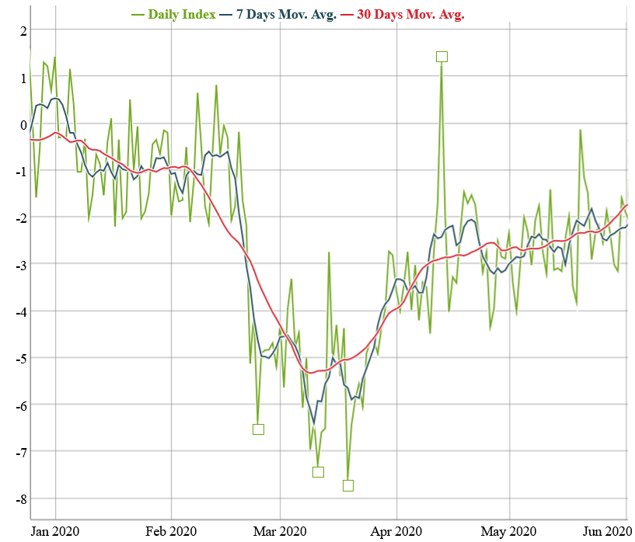
Use Case 1: AI for Sentiment Analysis
ISTAT’s SMEI January-May 2020: the Covid outbreak in Italy
The Social Mood on Economy Index (SMEI) is developed by ISTAT
Measures the Italian sentiment on economy
Extracts the sentiment from Twitter data
The sentiment analysis is conducted using a lexicon-based, unsupervised, approach

Slide 3
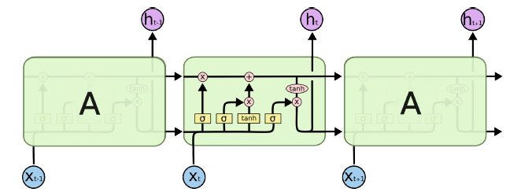
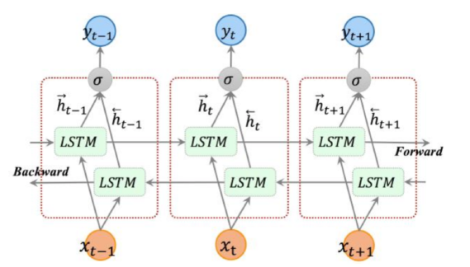
Use Case 1: AI for Sentiment Analysis
Bidirectional LSTM
Our classification model is a Bidirectional Long short-term memory (BiLSTM). LSTMs are a type of RNN able to process long sequences of data whereas BiLSTM are able to understand the left context and right context of sequences.
A LSTM memory cell is composed of 4 units exactly: an input gate, an output gate, a forget gate and a self-recurrent neuron.

Slide 4
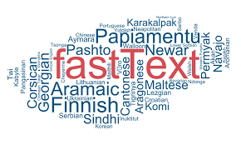
Use Case 1: AI for Sentiment Analysis
FastText
Our Word Embeddings Model (Catanese, E., Bruno, M., Stefanelli, L., & Pugliese, F., 2023, September - Winner of the Best Paper Award - 1st Place - CARMA 2023) is FastText which is an evolution of Word2Vec.
FastText enables to quickly train models on large corpora
FastText make use of hierarchical soft-max based which is able to noticeably drop computational complexity and can be trained on more than one billion words in less than ten minutes using a standard multicore CPU.

Slide 5
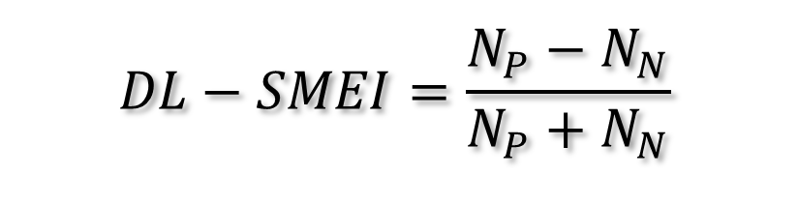
Use Case 1: AI for Sentiment Analysis
Why a new Index?
Computed daily using the sentiment predicted by the model on a set of tweets
The sentiment is predicted using a neural network
The set of tweets is the same used by ISTAT for the SMEI
Computed for the first half of 2020
ISTAT’s Index (SMEI) needed a revision to deal with new events (Covid pandemic)
The proposed model may have a higher adaptability to new information
The proposed model is a neural network that has been trained on a set of labelled Tweets that do not contain references to the pandemic
$$DL−SMEI=\frac{N_{P}−N_{N}}{N_{P}+N_{N}}$$

Slide 6
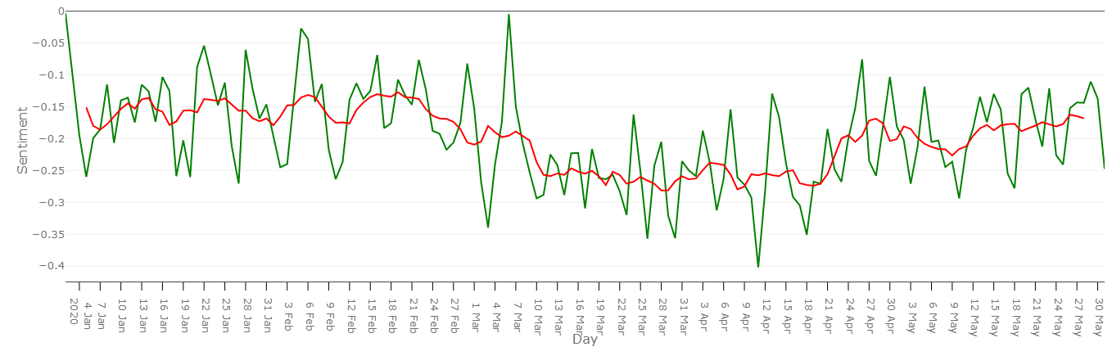
Use Case 1: AI for Sentiment Analysis
The proposed Index (DL-SMEI)
+ 10.3% negatives
-0.157
-0.260
-0.190

Slide 7
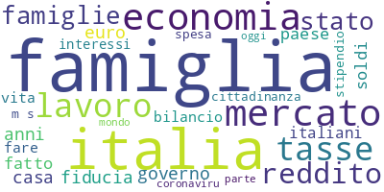
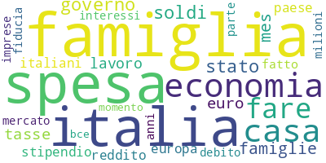
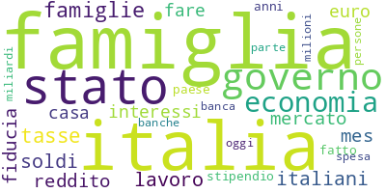
Use Case 1: AI for Sentiment Analysis
1st January – 7th March
8th March – 21st April
22nd April – 31st May

Slide 8
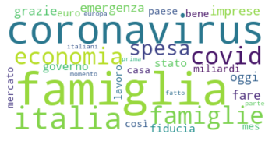
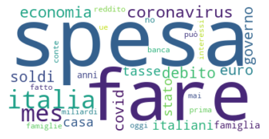
Use Case 1: AI for Sentiment Analysis
Focus on second period (8th March – 21st April)
Positive words
Negative words

Slide 9
Use Case 1: AI for Sentiment Analysis
Maximum and Minimum points

Slide 10
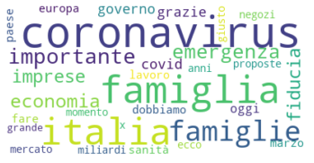
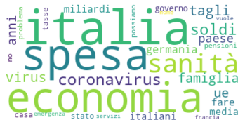
Use Case 1: AI for Sentiment Analysis
Second Maximum on the 6th March
Positive words
Negative words

Slide 11
Use Case 2: AI for Land Cover
GOALS
Land Cover (LC) statistics (Bernasconi, E., De Fausti, F., Pugliese, F., Scannapieco, M., & Zardetto, D., 2022) and maps are a very important statistical product. As they require a big effort to be created, the idea is to build an automatic system that processes satellite images in order to generate:
Automatic Land Cover Estimates
Automatic Land Cover Maps

Slide 12

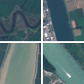
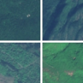
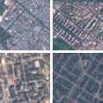
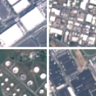
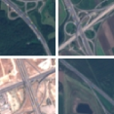

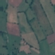
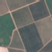
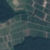


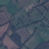
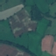
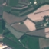
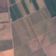






Use Case 2: AI for Land Cover (
ANNUAL CROP
RIVER
FOREST
EuroSAT dataset (https://github.com/phelber/eurosat):
Based on Sentinel-2 satellite images
27000 geo-referenced and labeled image patches (each one of 64x64 pixels)
10 different Land Use and Land Cover classes, with 2000-3000 images per class
RGB (8-bit) and Multi-Spectral (13 spectral bands, 16-bit) versions available
RESIDENTIAL
INDUSTRIAL
HIGHWAY
PASTURE
PERMANENT CROP
SEA LAKE
HERBACEOUS VEGETATYION

Slide 13
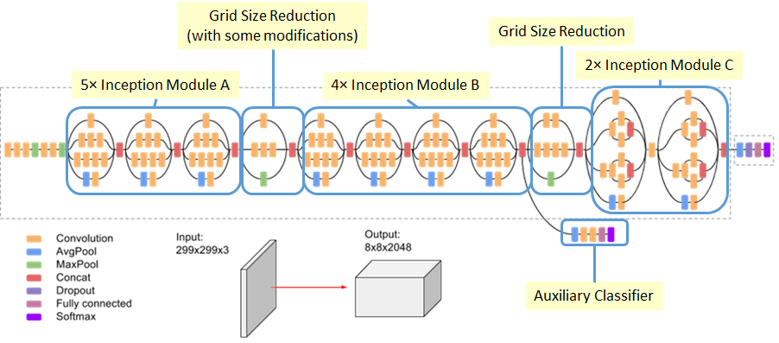
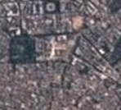
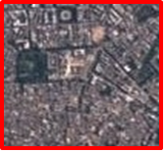
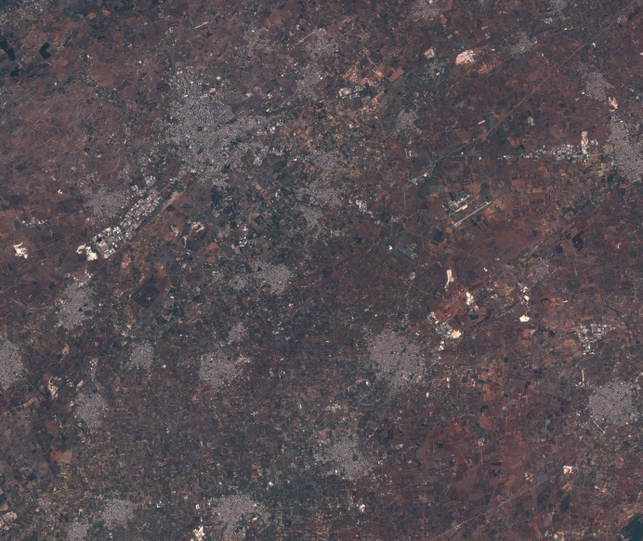
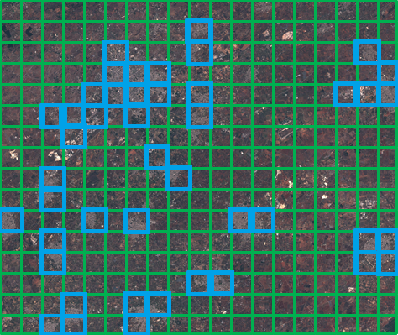
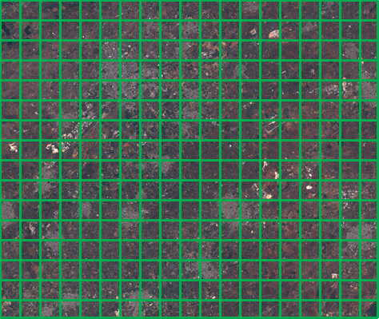
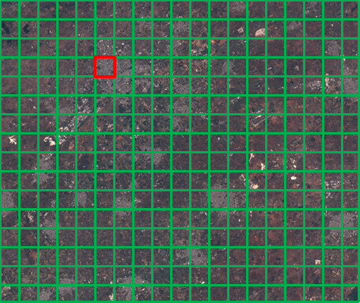
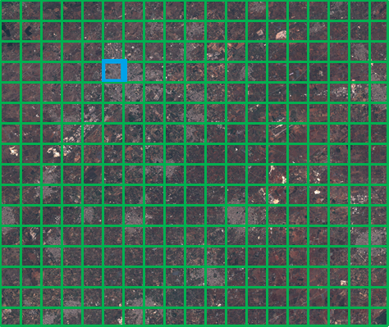
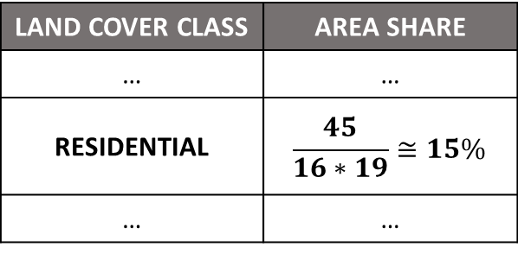
Use Case 2: AI for Land Cover
Classify-and-Count
Approach
CNN: Inception-V3 Archite
RESIDENTIAL
Input Satellite Image

Slide 14
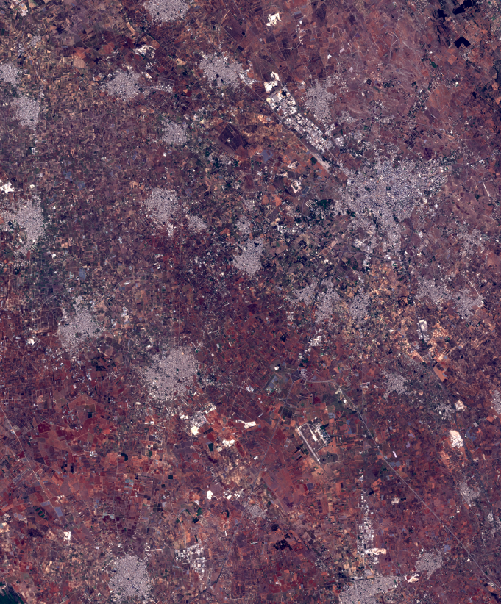
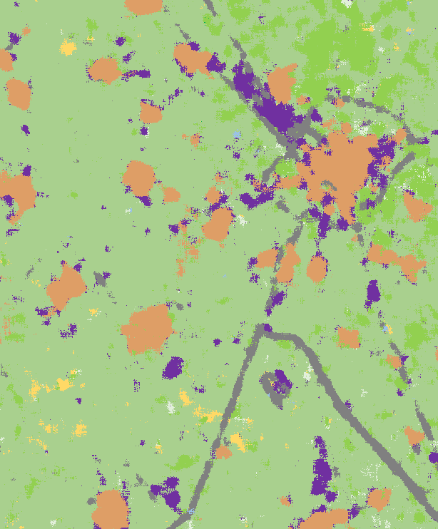
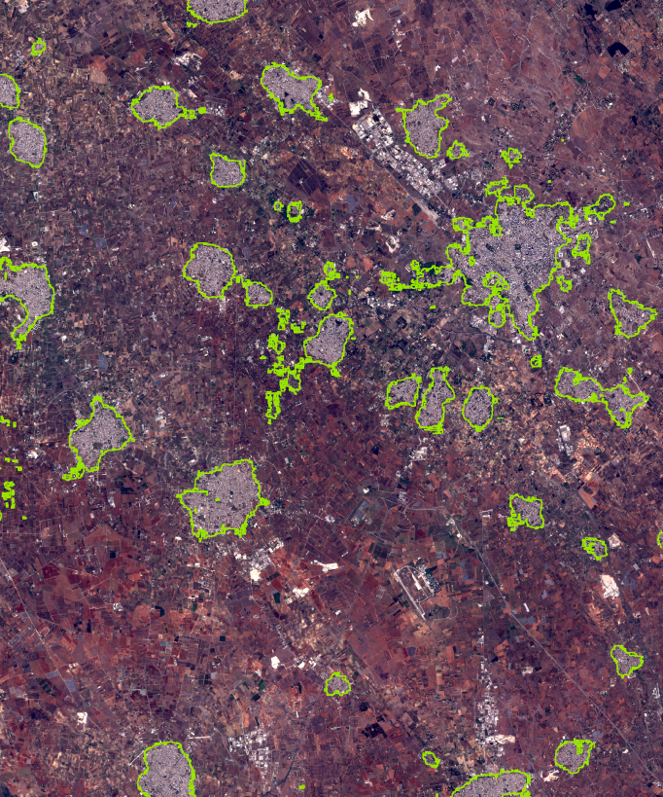
Use Case 2: AI for Land Cover
[A]
The ‘Lecce image’ (751 km²)
[B]
Automated LC map derived from the ‘Lecce image’
[C]
Edge line of the ‘Residential’ class derived from [B] overlaid on [A]

Slide 15
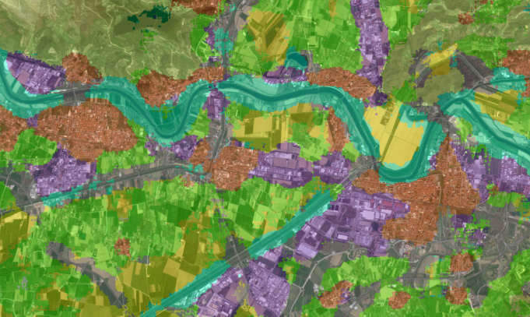
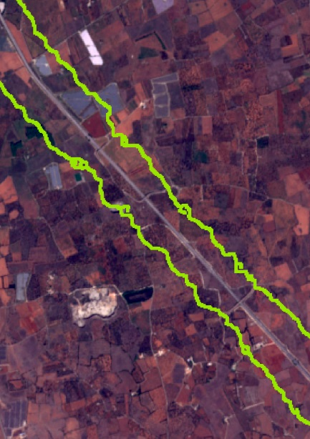
Use Case 2: AI for Land Cover
~500 m
~600 m
[D]
A detailed view of the course of the Arno River (cropped from the ‘Pisa image’, 443 km²) overlaid with a semitransparent version of the corresponding automated LC map
[E]
A highway fragment from the ‘Lecce image’ overlaid with the edge line of the ‘Highway’ class

Slide 16

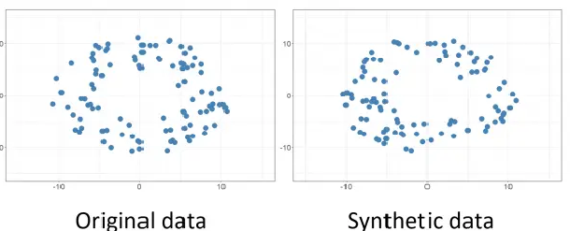
Use Case 3: AI for the generation of Synthetic Data
With the digitalization of information and the increasing accessibility of administrative data, the amount of data to be handled has grown substantially in recent years. This raises significant concerns about data protection and privacy since the disclosure of sensitive information can pose serious risks to individuals, institutions, and public administrations.
Synthetic data (Pugliese, F., Pappagallo, A., & De Cubellis, M., 2024, June) are artificially created datasets intended to replicate the statistical characteristics and structure of real data, while preventing the exposure of sensitive or personally identifiable information.

Slide 17

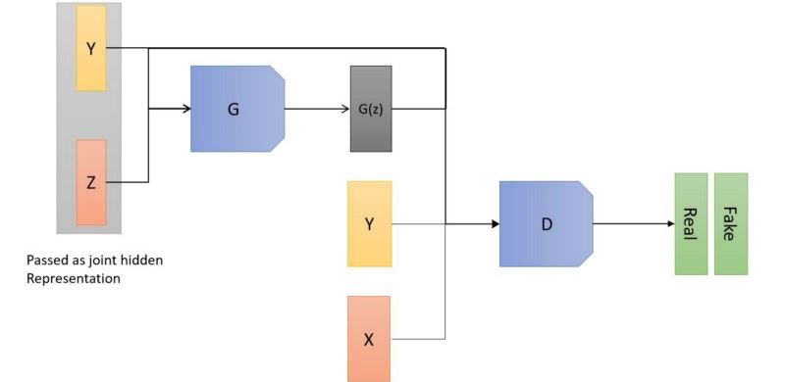
Use Case 3: AI for the generation of Synthetic Data
Keep in mind! Synthetic data do not necessarily reproduce the atomic data (categorical, numerical, etc) from the original source. Synthesis capability might rely rather on the relationships between different kind of entities, such as people and objects, school and neighborhoods, or users and cellular antennas.
In this study, the analyzed data relate to the frequency and attributes of trips and vacations undertaken by residents of Italy. They originate from the Istat Trips and Holidays survey, as a module of the Household Budget Survey (HBS) which collects information on the tourism flows of residents. This information includes journeys made for leisure or work, both domestically and internationally.
In the WP13’s Istat PoC of AI/ML Essnet project, we compared different AI methods: CT-GAN, VAEs, DP-CTGAN, SMOTENC, Random Forest, XGBoost

Slide 18
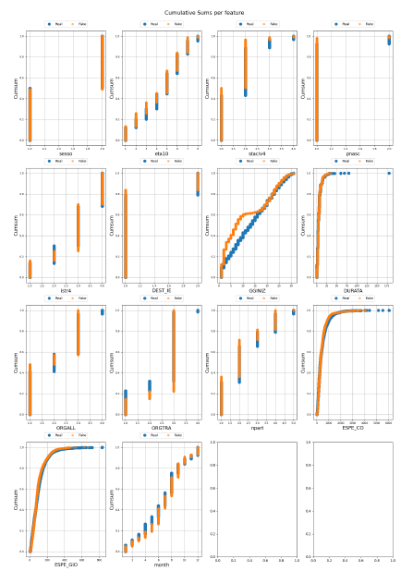
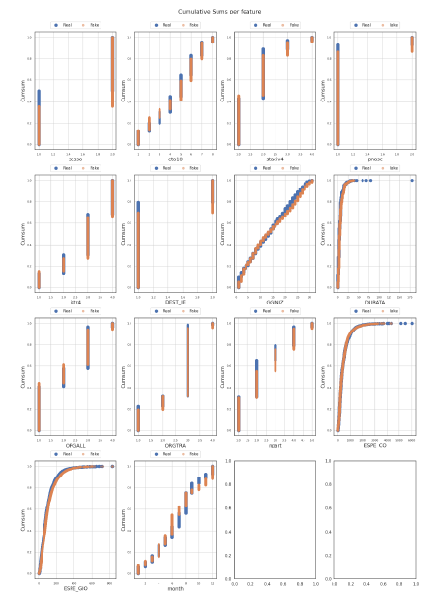
Use Case 3: AI for the generation of Synthetic Data
Note: In the original distribution itself, the values are not sums of previous values. Only in the cumulative sum version do the values accumulate.
It is evident from the cumulative distributions that the less effective methods, such as Random Forest or XGBoost, are less efficient on categorical variables, where they often fail to reproduce the categories, i.e. the domain values of these variables.
Variational Autoencoder (VAE)
CT-GAN

Slide 19
Use Case 3: AI for the generation of Synthetic Data
As we can observe, apart from SMOTENC which tends to reproduce the data exactly, the best methods seem to be the deep learning–based ones such as CTGAN and VAE, as they achieve high accuracy but not identical to the original dataset, as expected. In fact, during the synthetic data generation process something is always lost in terms of the properties of the data being reproduced.
Model | Accuracy | F1-Score | Recall
Original Data | 0.964516848 | 0.964516848 | 0.964516848
RF | 0.660685592 | 0.660685592 | 0.660685592
XGB | 4.46349e-05 | 4.46349e-05 | 4.46349e-05
SMOTENC | 0.992813783 | 0.992813783 | 0.992813783
DPCTGAN | 4.46349e-05 | 4.46349e-05 | 4.46349e-05
VAE | 0.892385288 | 0.892385288 | 0.892385288
CTGAN | 0.896134619 | 0.896134619 | 0.896134619

Slide 20
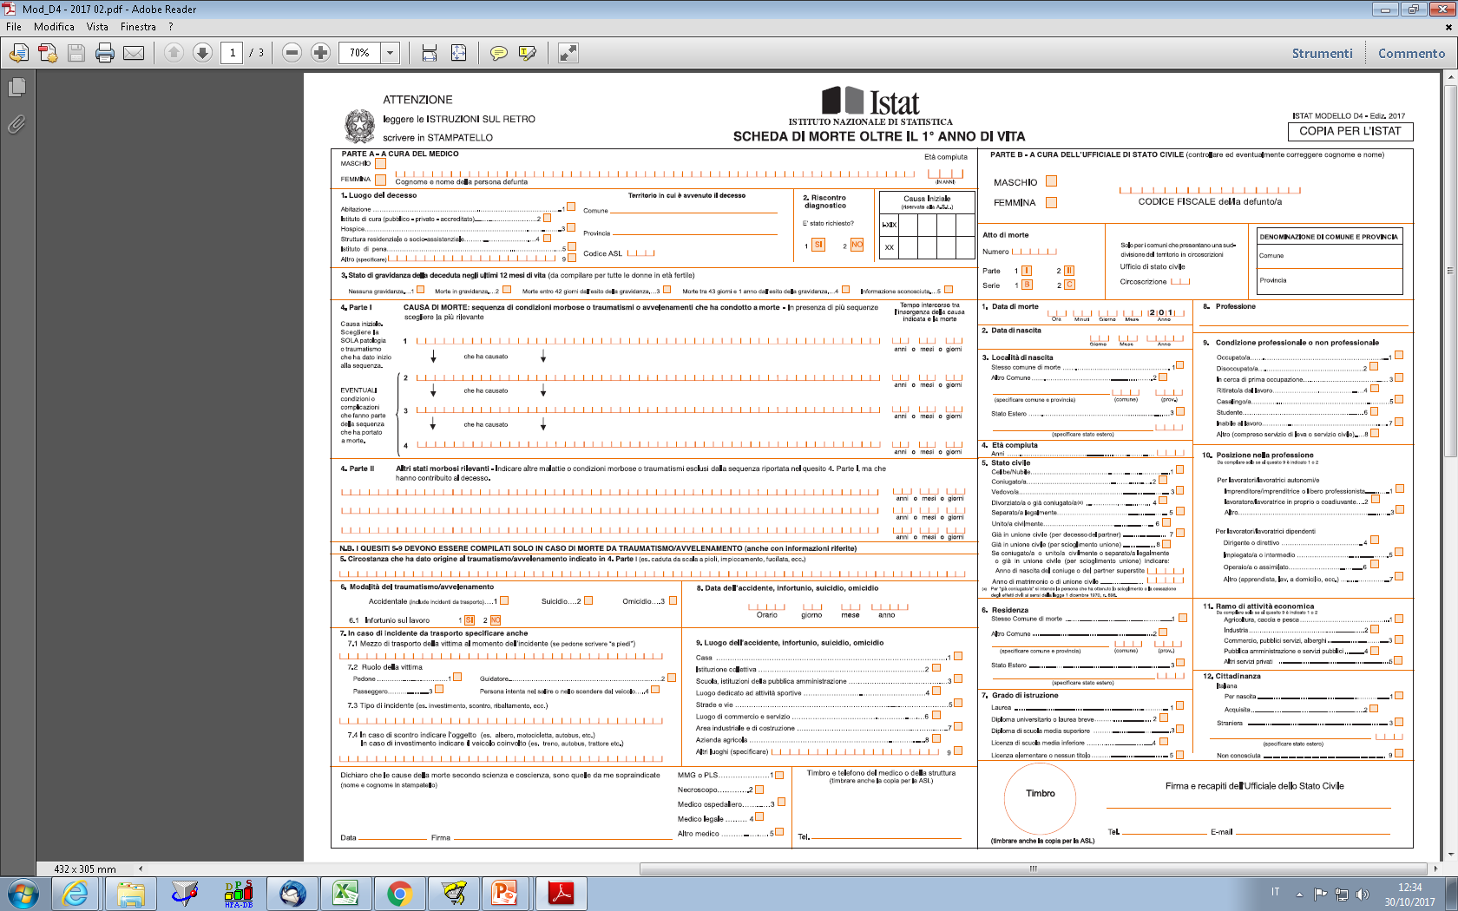
Use Case 4: AI for the automatic classification of Causes of Death
Detection Model
For each individual death occurring within the national territory, the certifying physician records the information on the causes of death in this part of the paper certificate
Istat Form D4-D4bis ‘Death Certificate

Slide 21
Use Case 4: AI for the automatic classification of Causes of Death
The project aims to:
identify the most suitable AI methods for coding causes of death;
create an algorithm for coding causes of death by applying these methods;
evaluate the performance of automatic coding and the quality of the data by applying this algorithm.
The main expected results are:
a reduction in coding variability among coders and in errors, resulting in improved quality;
in view of the imminent replacement of the paper form with an electronic model, AI methods will be useful to maintain high performance in recognizing medical text, even in the absence of the preprocessing currently applied during the registration of paper forms.
an increase in the number of death certificates coded completely automatically, without human intervention;

Slide 22
Use Case 4: AI for the automatic classification of Causes of Death
The information on the causes is recorded by physicians on a paper death certificate, digitized, and coded according to the tenth revision of the International Classification of Diseases (ICD-10) of the World Health Organization (WHO).
The application of the ICD is a complex process that involves:
first, assigning a code to all the causes certified by physicians on the forms (multiple causes).
then, selecting only one code for each death: the underlying cause.
Both phases are carried out according to the rules described in the ICD, and both the multiple causes and the underlying cause are used for mortality statistics.

Slide 23
Use Case 4: AI for the automatic classification of Causes of Death
Training set 22_23: about 4 million texts. 53,876 classes after class cleaning and drops with cutoff. Too much data for training: we sample progressively (starting from 300,000 texts).
DS_Gold_standard (external): 951 texts assigned a code whose correctness has been verified.
TEST_08_09 (test_set_blind): 11,909 texts to be labeled.
Valid ICD codes Flag (A, C, CON, P, etc). Example: Separators (‘;’, ‘/’, etc). Example: CACHESSIA TERMINALE CON IRA IN GRANDE ANZIANO coded as N179 / R54.
(Note: “Cachessia terminale con IRA in grande anziano” = “Terminal cachexia with acute renal failure in a very elderly patient.”)

Slide 24
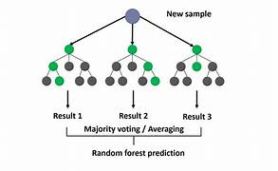
Use Case 4: AI for the automatic classification of Causes of Death
TF-IDF on the dataset to obtain the normalized term-document matrix; Random Forest is used for classification (which works on SL).
We take a sample of 300,000 texts for training. Initially 54,767 classes, later reduced to 27,364, after non-semantic splitting (in cases where the number of classes equals the number of texts). We use a cutoff of 2, meaning we consider only classes with at least two instances. There are about 17,666 classes that appear only once, and these are removed. In the end, we are left with 9,698 classes.

Slide 25
Use Case 4: AI for the automatic classification of Causes of Death
On training set of 300,000: Accuracy: 0.9761% F1-score (macro-weighted): 0.9745%
On test set (20%): Accuracy: 0.9467% F1-score (macro-weighted): 0.9422%
Accuracy on test set of about 65,161 texts:
#codes = #texts (size = 63,636, 97.66% of the test dataset): Accuracy: 0.9528% – F1-score (macro-weighted): 0.9505%
#codes > #texts (size = 1,525, 2.34% of the test dataset): Accuracy: 0.69% – F1-score (macro-weighted): 0.71% → 1,060 correct, 465 incorrect (outputs exported to Excel and CSV for sharing)
#texts > #codes (size = 0)
(Note: The “%” signs seem to be used instead of decimals — e.g., accuracy 0.9761 likely means 97.61%.)

Slide 26
Use Case 4: AI for the automatic classification of Causes of Death
Accuracy on test set of about 65,161 texts: #codes > #texts (size = 1,525, 2.34% of the test dataset): Accuracy: 0.69% – F1-score (macro-weighted): 0.71% → 1,060 correct, 465 incorrect.
The correct cases are mostly those in which one text corresponds to two codes.
We check what percentage of the texts corresponding to the correct cases are present in the training set: 915 out of 1,050 (86%). We check what percentage of the texts corresponding to the incorrect cases are present in the training set: 76 out of 475 (16%).
Theory: Random Forest performs well when it finds the same words combined in the same way in the training set.

Slide 27
Use Case 4: AI for the automatic classification of Causes of Death
Accuracy on test set (sample of 950 “gold_standard” texts): For this dataset, the initial number of classes is 876. After non-semantic splitting (in cases where the number of classes equals the number of texts — i.e., for 197 cases), we obtain 847 classes, and the number of texts to be classified becomes 1,154. The classes are reduced to 716 after removing the time period.
Accuracy on “gold_standard” test set: overall 0.41% F1-score → problem: only 24% of the gold standard texts are present in the training set, while 62% of the classes are present in the training set.
#codes = #texts (size = 948, 82.15% of the gold standard dataset): Accuracy: 0.55% – F1-score (macro-weighted): 0.52%
#codes > #texts (size = 206, 17.85% of the gold standard dataset): Accuracy: 0.033% – F1-score (macro-weighted): 0.033% → 7 correct, 199 incorrect (outputs exported to Excel and CSV for sharing)
#texts > #codes (size = 0)
OBSERVATION: for the label encoding of the classes, we include both the classes present in the training set and those in the gold standard, to prevent cases where classes in the gold standard are missing from the training data. In the previous case, this issue did not arise because we had obtained it using a stratified train-test split, which ensures that each class has a sample in both the training and test sets.

Slide 28
References
[1] Catanese, E., Bruno, M., Stefanelli, L., & Pugliese, F. (2023, September). Measuring Social Mood on Economy during Covid times: effects of retraining Supervised Deep Neural Networks. In 5th International Conference on Advanced Research Methods and Analytics (CARMA 2023) (pp. 139-147). Editorial Universitat Politècnica de València.
[2] Bernasconi, E., De Fausti, F., Pugliese, F., Scannapieco, M., & Zardetto, D. (2022). Automatic extraction of land cover statistics from satellite imagery by deep learning. Statistical Journal of the IAOS, 38(1), 183-199.
[3] Pugliese, F., Pappagallo, A., & De Cubellis, M. (2024, June). Generation of Synthetic Data from Mobile Network Operators (MNO) Data Through Generative Adversarial Networks (GANs). In Scientific Meeting of the Italian Statistical Society (pp. 69-74). Cham: Springer Nature Switzerland.

Slide 29
Thanks
FRANCESCO PUGLIESE | francesco.pugliese@istat.it

